Slide 1


Slide 2

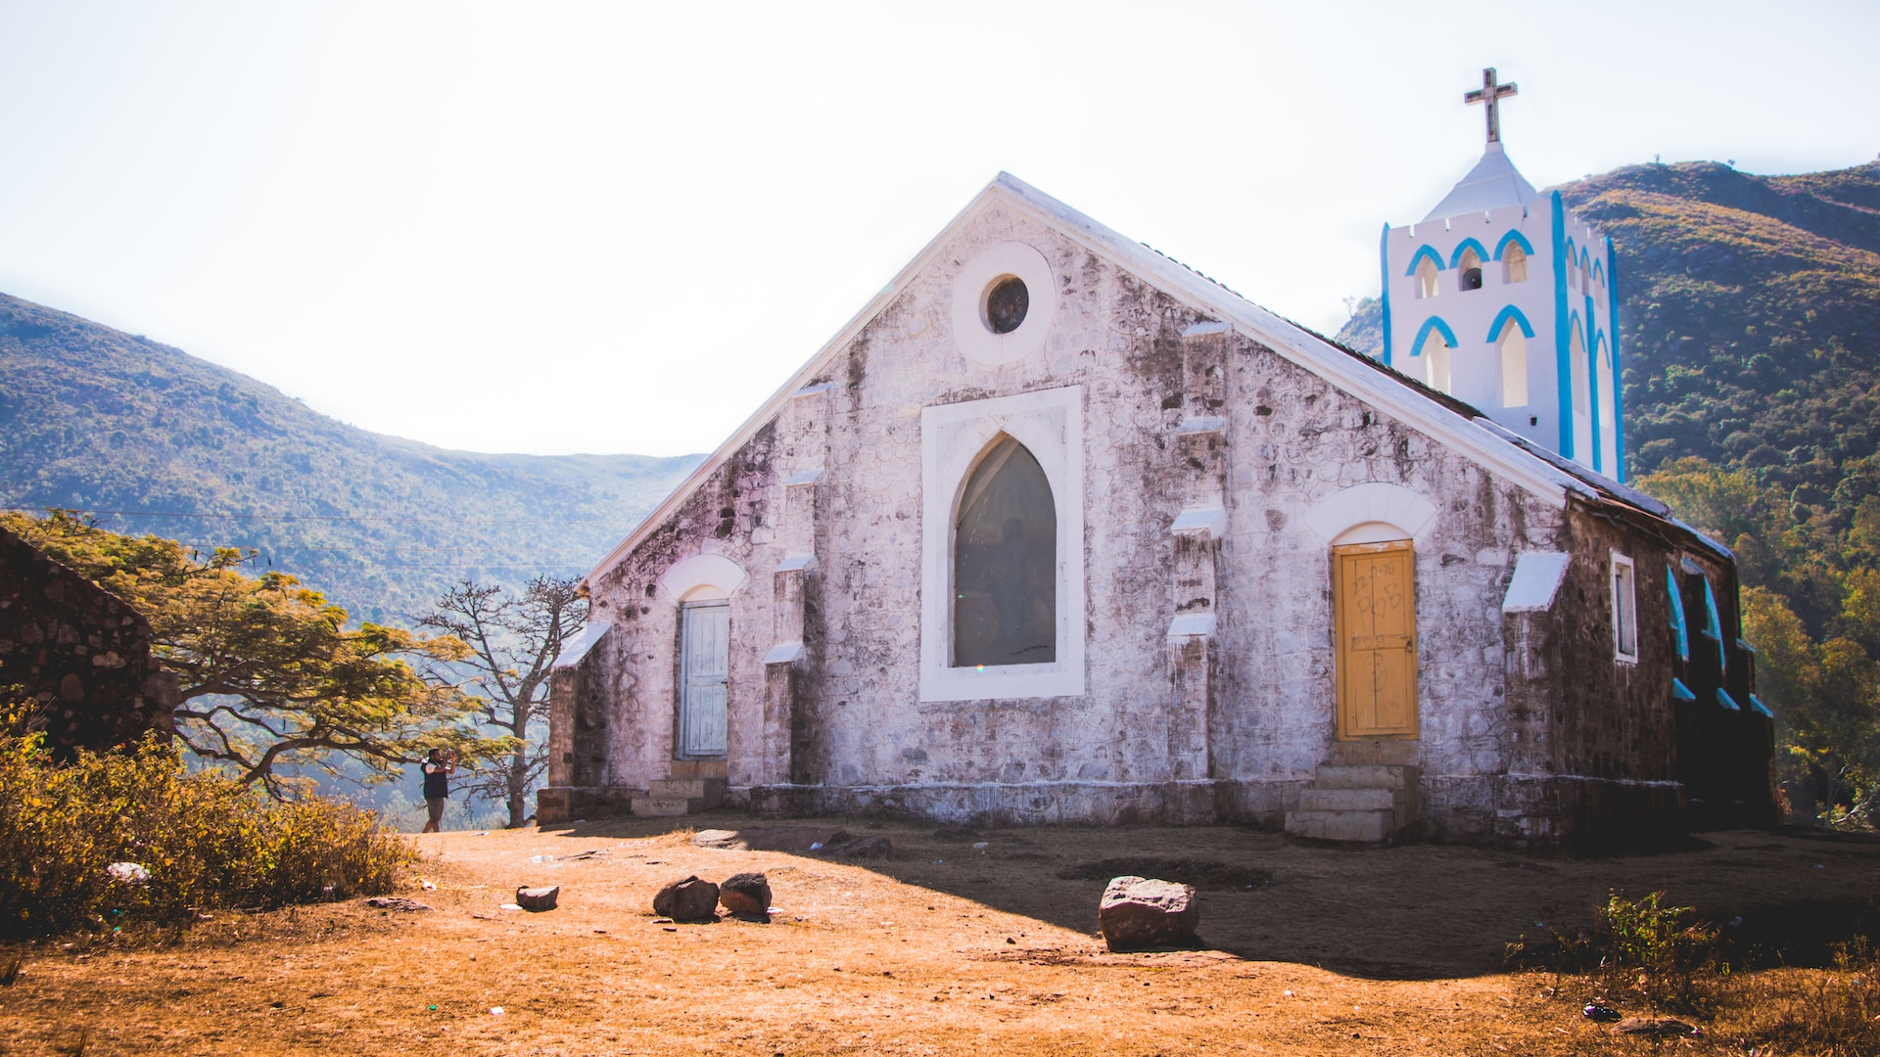

The Church Strengthened for Mission:
Theologically Shaping Pastoral Training
Michael A. Ortiz
michael.ortiz@icete.info
Notes:
Theological Discernment

Slide 3
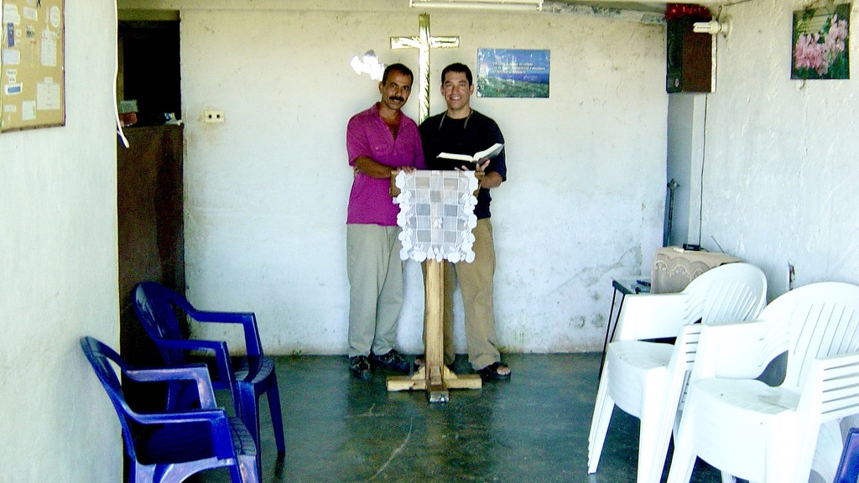

Slide 4
Lausanne Cape Town 2010
“The rapid growth of the Church in so many places remains shallow and vulnerable” mostly due to leaders who themselves have not been discipled and lack the “ability to teach God’s Word to God’s people.”
Notes:
Cape Town 87-88

Slide 5
Church Growth
According to the Global Alliance for Church Multiplication (GACX), the Church in Asia, Africa, and Latin America has grown from 30% of the world’s churches in 1970 to 70% by 2022.
In addition, the World Evangelical Alliance (WEA) representing churches in over 130 countries estimates there are 50,000 new baptized believers each day.

Slide 6


All God’s People
In order to be relevant for the church in mission in various contexts and situations, theological education is to be offered in many formats serving multiple needs. In addition, theological education must be accessible to all God's people. Special attention must be given to groups of people who have traditionally had and still have limited access to education: Neither gender nor social status, neither skin colour nor nationality, neither geographic location nor lack of personal connections should exclude people from theological education.
ICETE Manifesto II
Notes:
See also The rest of this statement says: “Theological education serves first to train those who lead the Church as pastor-teachers, equipping them to teach the truth of God’s Word with faithfulness, relevance and clarity; and second, to equip all God’s people for the missional task of understanding and relevantly communicating God’s truth in every cultural context” (Lausanne 2010, 107).

Slide 7
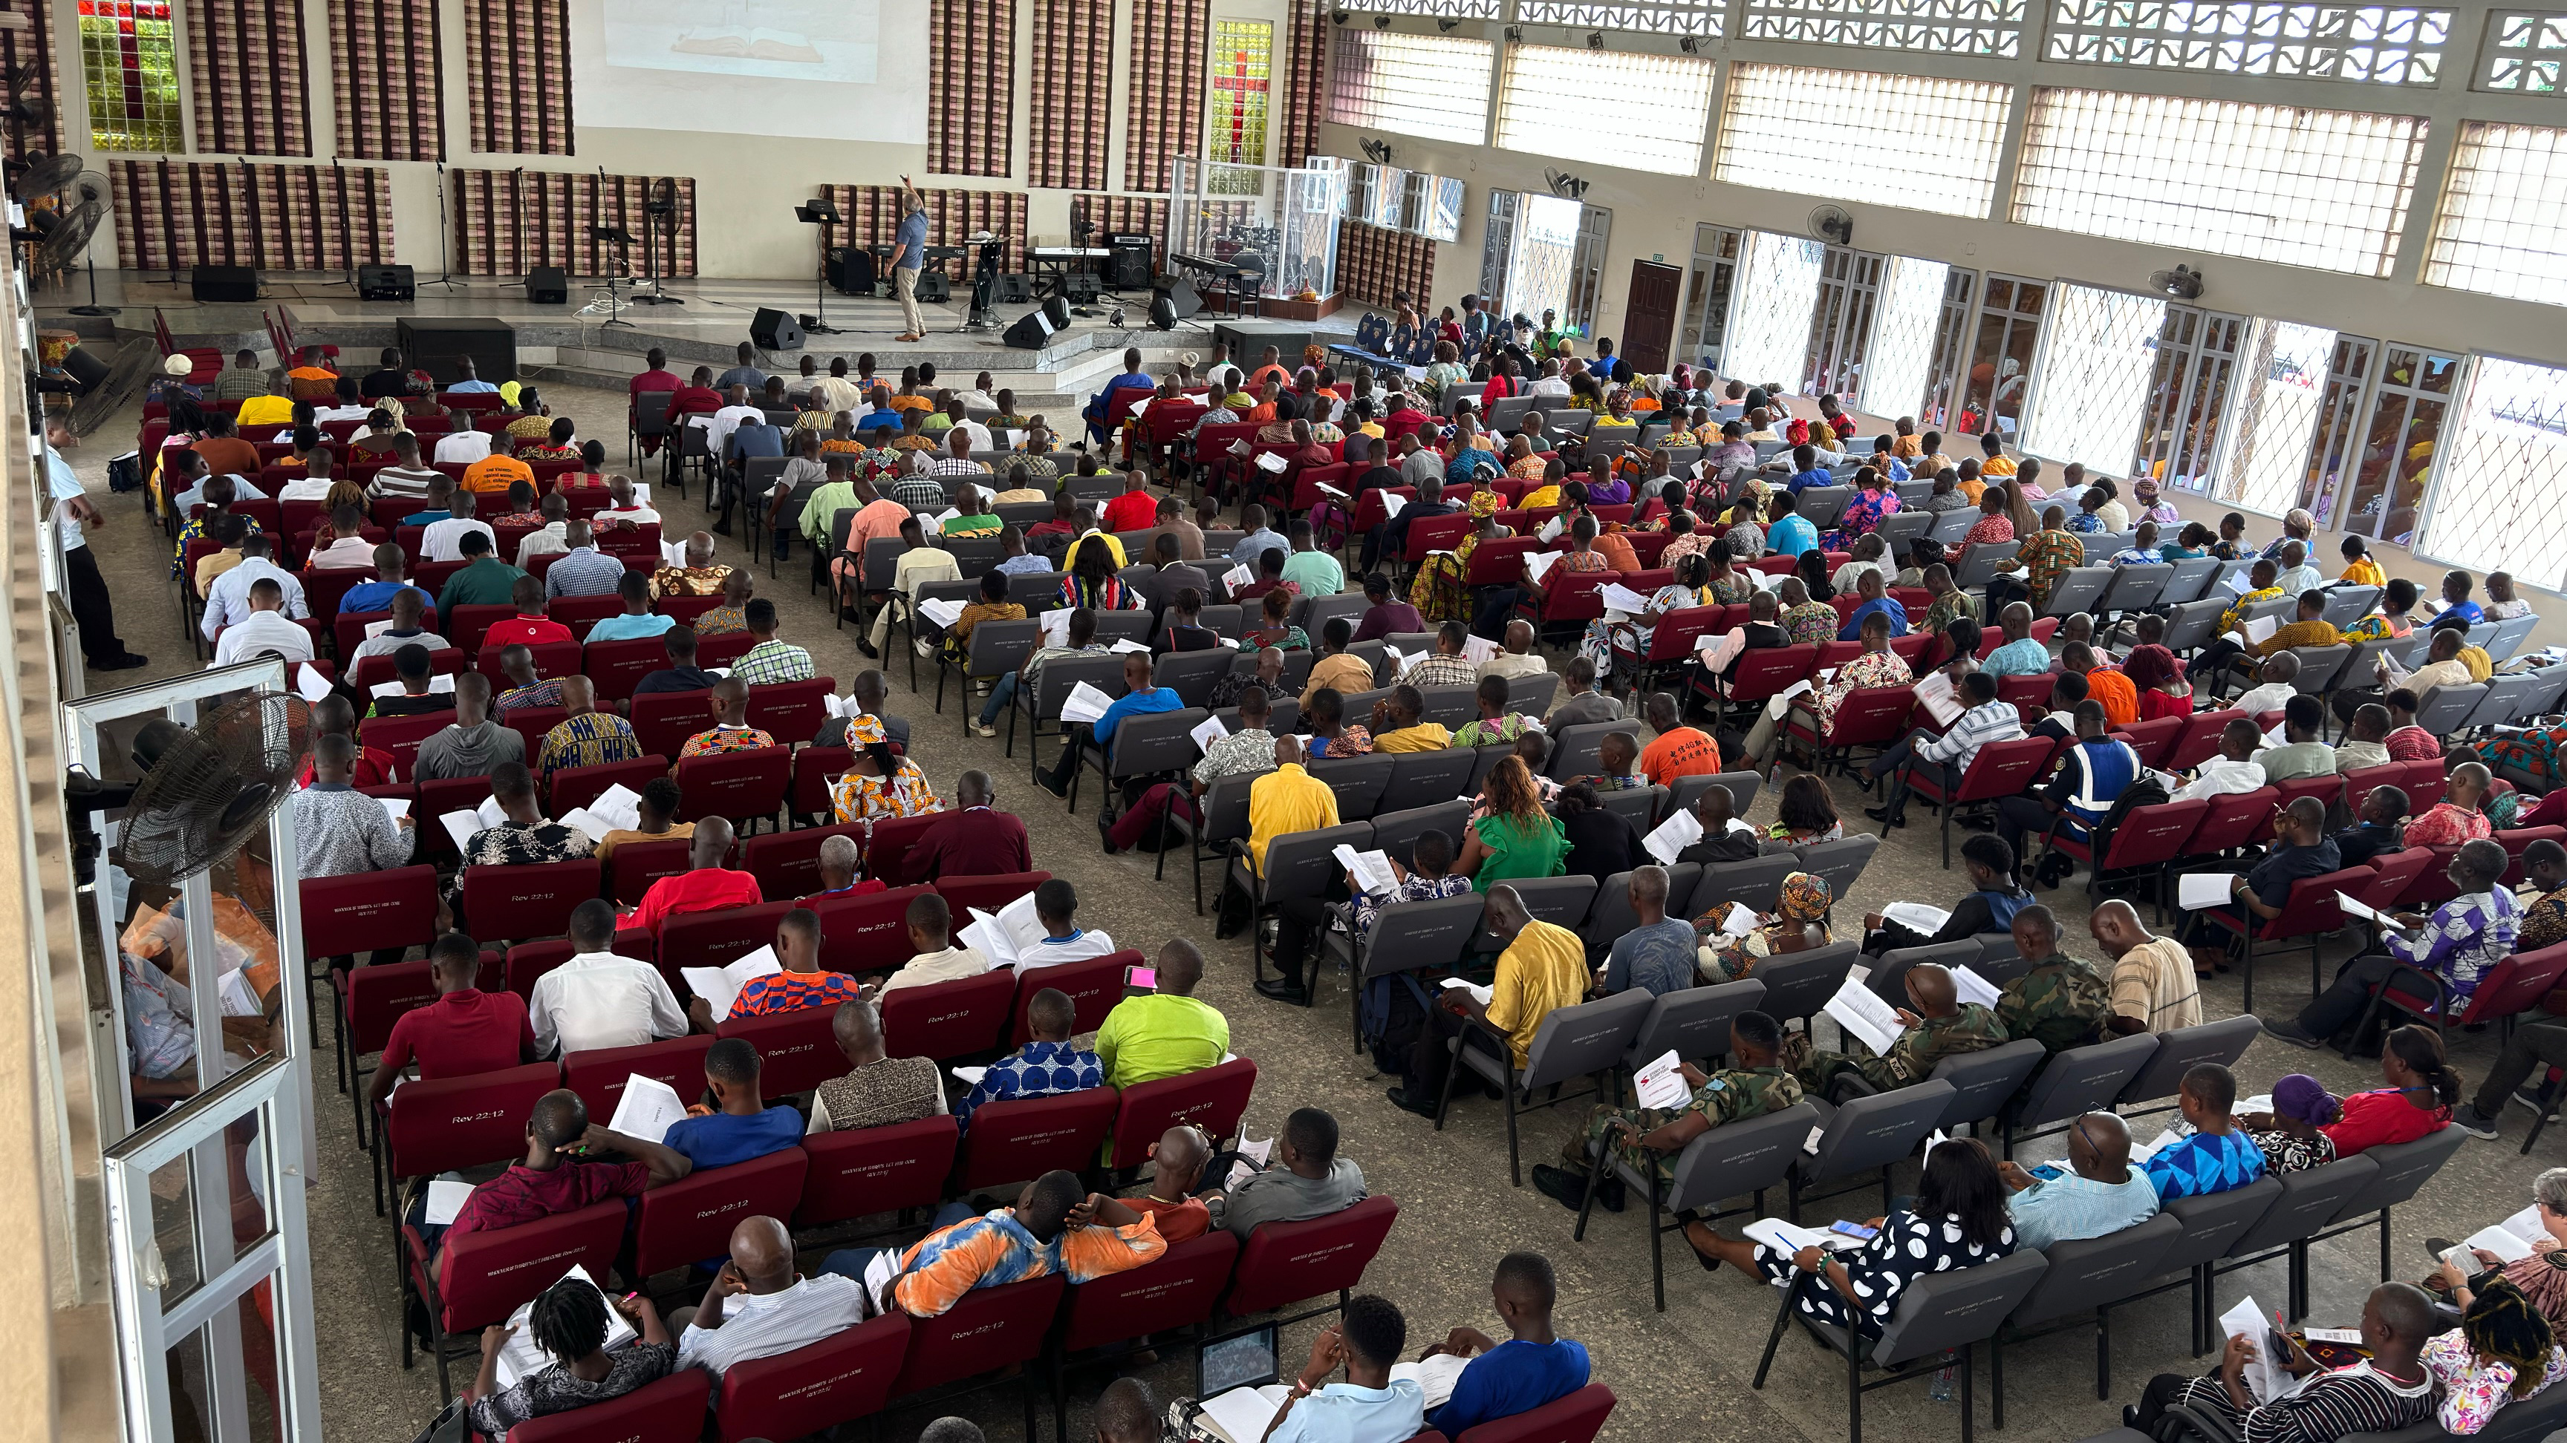

Slide 8
The Purpose of TE
ICETE Manifesto II
Perhaps the most formative insight of recent decades is the call for the integration of mission and theological education. The purpose of theological education must be defined within the framework of the missio Dei and a missional self-understanding of the Church.

Slide 9
Theological Education:
Missional Understanding of
the Church
2 Corinthians 11:1-4
Ephesians 5:25-27
Philippians 2:14-16; 4:1
Colossians 1:21-23
1 Thessalonians 1:2-3:5
2 Timothy 2:1-2
Hebrews 10:23-25
1 Peter 5:1-4
2 Peter 3:14-18
Jude 17-25

Slide 10
Lausanne Cape Town 2010
The mission of the Church on earth is to serve the mission of God, and the mission of theological education is to strengthen and accompany the mission of the Church.
Notes:
Cape Town 87-88

Slide 11
TE as God’s Instrument
Theological education, regardless its form, should stand within a missional-ecclesial framework. That is to say, it cannot operate set apart, isolated from its role as an instrument of God’s mission, a mission to be carried out through the Church, God’s missionary people. Michael A. Ortiz
Notes:
Romans 6:112-13
Perhaps a military, supervisory motif
Instruments tool, but could be weapons, such as those that might be used in a war battle
present is first in the present tense, then aorist – present yourself fully, completely lacking nothing; Rom 12:1
Being at full attention

Slide 12
Typical TE Responses
Reset
Rework
Rebrand
Reconfigure
Renewal
Notes:
Romans 6:112-13
Perhaps a military, supervisory motif
Instruments tool, but could be weapons, such as those that might be used in a war battle
present is first in the present tense, then aorist – present yourself fully, completely lacking nothing; Rom 12:1
Being at full attention

Slide 13
TE Recalibrated
Together, we can recalibrate theological education to its intended true course as an instrument of God to steady the Church for its mission.
Michael A. Ortiz
Notes:
Romans 6:112-13
Perhaps a military, supervisory motif
Instruments tool, but could be weapons, such as those that might be used in a war battle
present is first in the present tense, then aorist – present yourself fully, completely lacking nothing; Rom 12:1
Being at full attention

Slide 14
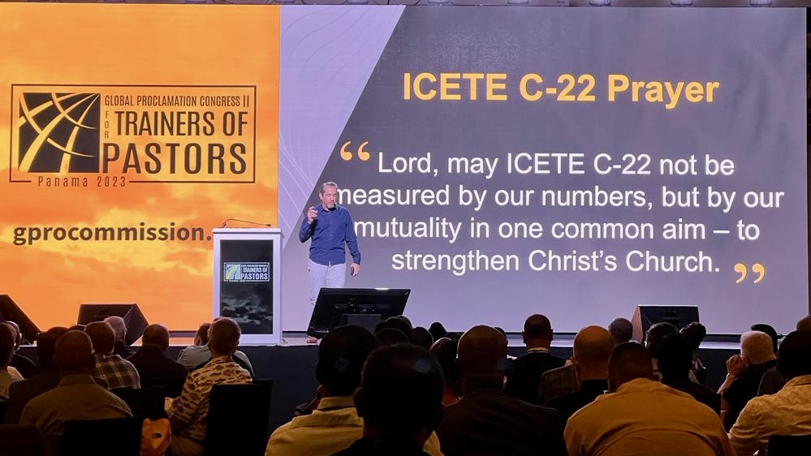

Slide 15
Ecclesia
Impact
Voices
Notes:
I have eight, but will be giving you only four

Slide 16
Ecclesia
Theological education is most alive when it accompanies the ecclesia through current realities and anticipates future challenges.
Notes:
Life breath
More reactive than proactive
TE struggling everywhere – Not just about money
Innovation

Slide 17
Impact
Impact must be measured beyond the content delivered.
Notes:
Not just about QA and accreditation
Are you really doing what you think you’re doing??
Content, Character, Craft, re Continuity, Community,

Slide 18
Voices
The future of theological education will depend on the voices it is willing to elevate and embody.
Notes:
Programmes and institutions of theological education as well as the church are challenged to take concrete measures to bridge the gap between church and academy.
Speak about Impact!!!!!
Voices represent Current Realities and Future Troubles
MC is a new voice!!
Orality 80% oral learners
Women
Migration & Diaspora
PR
Social Issues
Family
Missionary Training

Slide 19


ICETE C-25
Next for Theological Education
3-7 March 2025
Dubai
Notes:
Life breath
More reactive than proactive
TE struggling everywhere – Not just about money
Innovation

Slide 20
ICETE C-25
Voices to Elevate & Embody
ICETE Impact Teams
Notes:
Life breath
More reactive than proactive
TE struggling everywhere – Not just about money
Innovation

Slide 21
Global Reflections to Recalibrate TE
Ecclesia
Relevance
Impact
Transform
Voices
Elevated

Slide 22
Questions & Comments
Notes:
Programmes and institutions of theological education as well as the church are challenged to take concrete measures to bridge the gap between church and academy.
Speak about Impact!!!!!
Voices represent Current Realities and Future Troubles
MC is a new voice!!
Orality 80% oral learners
Women
Migration & Diaspora
PR
Social Issues
Family
Missionary Training

