Slide 1
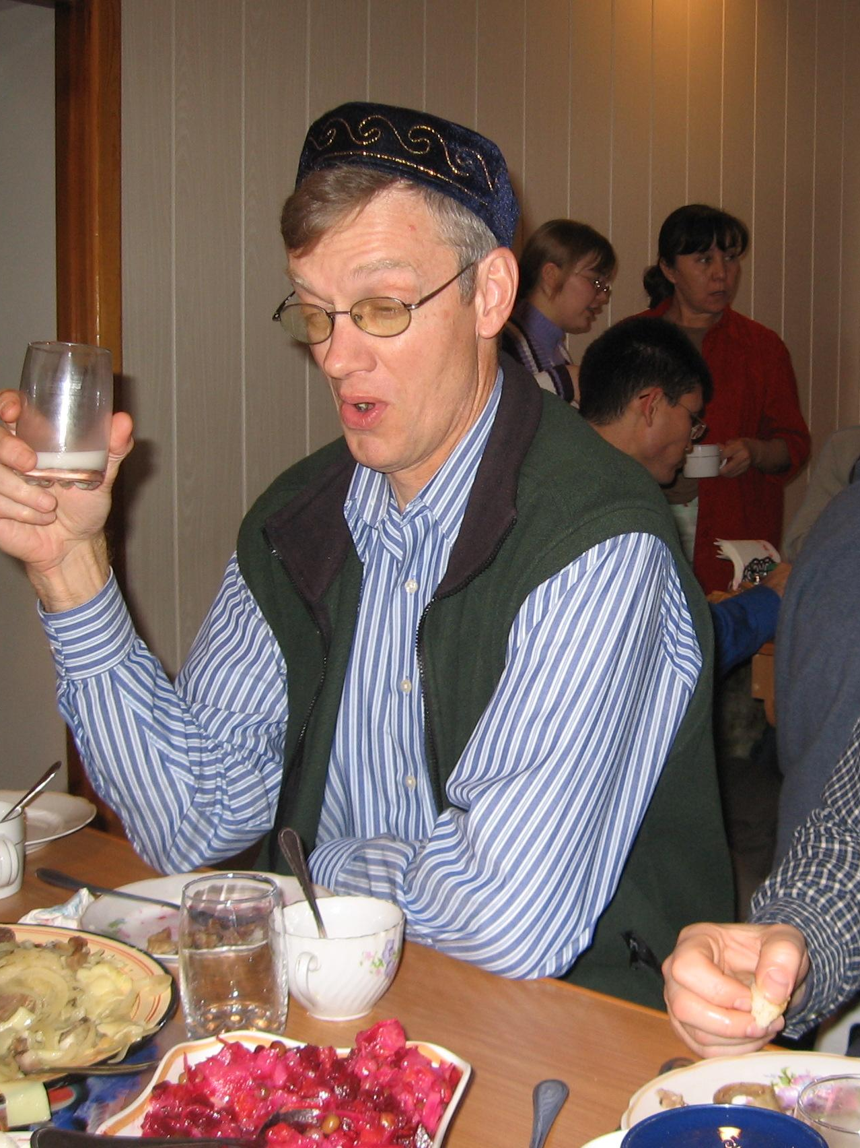
DEVELOPING A PLAN TO TRAIN TRAINERS:
MAKING 2 TIMOTHY 2:2 A REALITY
CRAIG PARRO &
AL BRIDGES

Slide 2


WHAT “SUCCESS” LOOKS LIKE TODAY
By God’s grace, you will…
Learn key priorities and practices
Evaluate your own Train-the-Trainers process
Identify specific ways to improve as a Trainer-of-Trainers
Notes:
Start Recording
Huge, complex topic
A group effort…Thanks Carl Green, Jim Baugh, Larry Meeker, Paul Madson, Doug Vinez, Phil Graf, Linus

Slide 3
IS DEVELOPING TRAINERS YOUR PRIORITY?
If so, you have TWO major training goals…
1. Helping them learn the content well
BUT ALSO,
2. Helping them become effective trainers
How intentional are you?

Slide 4
WHAT IS YOUR PLAN TO DEVELOP TRAINERS?
You then, my child, be strengthened by the grace that is in Christ Jesus, and what you have heard from me in the presence of many witnesses entrust to faithful men, who will be able to teach others also. —2 Timothy 2:1-2

Slide 5
KEY PRIORITIES WHEN DEVELOPING TRAINERS
Get the right people in the room
Help them develop the skills they will need…
  Rightly handling God’s Word
  Facilitation skills
  Coaching skills

Slide 6
A SIMPLE PROCESS
I do, you watch
We do together
You do, I watch
I leave, you do

Slide 7
SOME PROVEN PRACTICES
1. Model, but also explain what you do…and why
2. Give lots of opportunities for practice
3. Provide feedback & encouragement
4. Be patient…expect progress, not perfection

Slide 8
FINAL THOUGHTS
1. Keep it relational
  2. Keep it simple
  3. Keep moving at their pace of learning
  4. Keep casting vision

Slide 9
QUESTIONS FOR YOUR BREAKOUT GROUPS
Think about the different aspects of developing trainers which were discussed. Share with the group which things you do well and where you need to improve/grow?
What one or two changes will you make as a result of today’s discussion?
Notes:
Start Recording
Huge, complex topic
A group effort…Thanks Carl Green, Jim Baugh, Larry Meeker, Paul Madson, Doug Vinez, Phil Graf, Linus

Slide 10
RESOURCES FOR YOU
www.craigparro.org has a number of resources for pastor-trainers, including a one-hour webinar on Training Trainers: Making 2 Timothy 2:2 a Reality.
Send us your Train-the-Trainers plan and one of us will be happy to provide feedback to you.
    AlBridges@gmail.com

