Slide 1
Regional Training Hubs
Presentation to GPro Commission
First Monday, October 2024

Slide 2



Slide 3


Slide 4


Europe, Central Asia,
North Africa, Middle East
Americas, English
Eastern
Asia
French
South
Asia
Africa, English
Americas, Spanish
Portuguese

Slide 5
Discussion in Each Region
What sorts of pastor training are needed in our region?
Which of these training needs can the resources you have help to meet?
Offers and requests
  Offer: ‘To meet the training need we are discussing, I (or my church or organization) could …’
  Request: ‘To serve well, we are looking for help with …’

Slide 6
Priorities in Spanish-Speaking Americas
Theological training
Training for a variety of pastors: young, rural, indigenous, etc.
Training in emotional healing, counselling, etc.
Training to teach better
Desire to repeat this process—gathering, listening, offering—at the country level

Slide 7
Priorities in the Portuguese-Speaking World
Connect the participants for continuing dialogue about ways to equip pastors
Plan a retreat for younger pastors in the Northeast of Brazil, for encouragement and connection to mentors
Provide online resources to groups of pastors for ongoing training

Slide 8
Priorities in English-Speaking Africa
Soul care, ministry burnout
Grassroots training programmes grown in the soil, where stakeholders themselves are involved in the design

Slide 9
Priorities in the Middle East & North Africa
Discipleship and leadership training resources for believers of Muslim background (see Word of Life’s curriculum)

Slide 10
Priorities in South Asia
Evangelism, disciple making, church planting
Mentoring, marriage, family
Finance, sustainability
Generous offers: e.g., free financial auditing
Formed a WhatsApp group to continue the conversation

Slide 11
Priorities in Eastern Asia
Effective training to keep pace with movements
New believers’ training
Soul care

Slide 12
Themes
We can train more leaders better together.
God entrusts resources to one group to meet the needs of another and so on.
This cycle of offering and receiving can create a network of interdependence and cooperation.
Effective pastor training is biblical, contextual, holistic, and transformative.

Slide 13
Regional Training Hubs
Connecting partners to train more leaders better together

Slide 14

Ready to set the table
With an others-focused posture of humility,
we offer training expertise
to connect partners
in relationships of trust and
mobilize trained leaders
as the Spirit enables.

Slide 15

Designing around the table
We invite churches, seminaries, and training partners.
Together we assess needs, plan strategy,
build capacity, and innovate.
This collaboration leads to
contextual, transformative
programmes and resources
that form leaders holistically.

Slide 16

Leaders formed holistically
Maturing believers,
strengthened by the Spirit
and shaped in community.
They serve in the way of Jesus,
loving faithfully, teaching biblically,
and equipping others.
They nurture churches that flourish.

Slide 17

Emerging leaders form others
Partners train together, breaking down silos.
Theological students and emerging leaders
mentor as they were mentored.
Scholars bridge theory and practice,
empowering churches
to serve effectively.

Slide 18
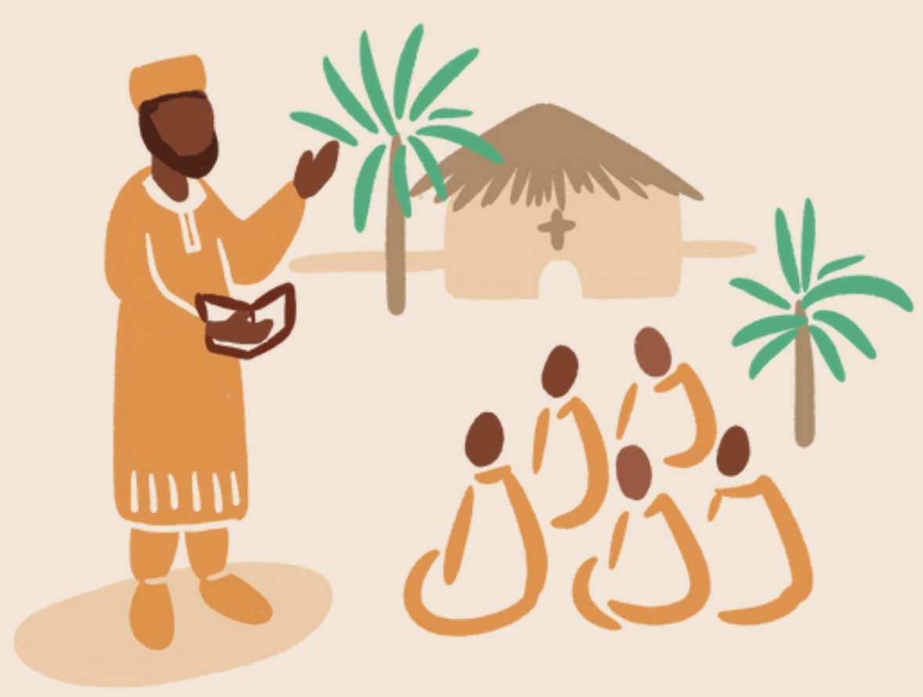
Well-led churches flourish everywhere
Proclaiming Christ’s gospel,
embodying it in reconciled communities,
and demonstrating it
through acts of service,
mercy, and justice.

Slide 19

Discussion Questions in Regions
Did you connect with someone at the GPro Congress with whom you now train together or partner in some way?
What are the challenges of training together?
What are the benefits?
As you look around your region, what are the greatest needs for training now?

